Slide 1
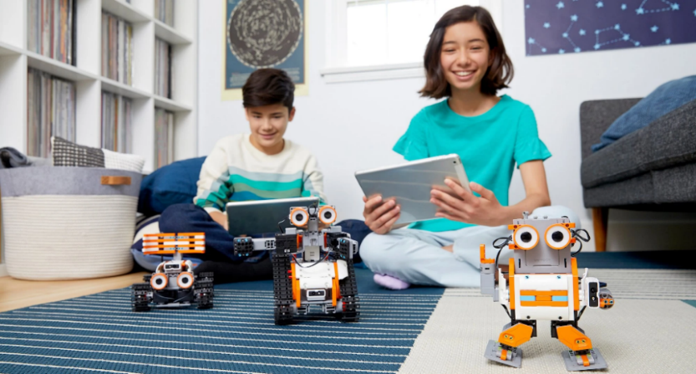
HCC Robotics Camps
Registration Forms
Website: www.fl-ate.org/projects/camps.html
Please fill out camp forms and mail them:
HCC Brandon Campus
c/o Susan Gerena
10451 Nancy Watkins Drive
Tampa, FL 33619
**Please do NOT drop off Registration Forms
Camp Details
Location:HCC- Brandon Campus
Monday – Friday 8:30am – 4:00pm
ALL GIRLS CAMP: FREE 6/29- 7/2
Costs: All other camps $250 per week
Campers must bring their own lunch
**all camp fees are nonrefundable
Camp Coordinator
Susan Gerena
Email: susan.gerena@hcps.net
Phone: (813) 344 – 4002
***Ask about need-based scholarships!
HCC subscribes to equity, access, diversity and inclusion.
In-Person Robotics Camps
JUNE 28 – JULY 2: All Girls Robotics*** FREE
JULY 12th – 16th: Intro Robotics
JULY 19th – 23rd: Intermediate
Robotics*

